Slide 1
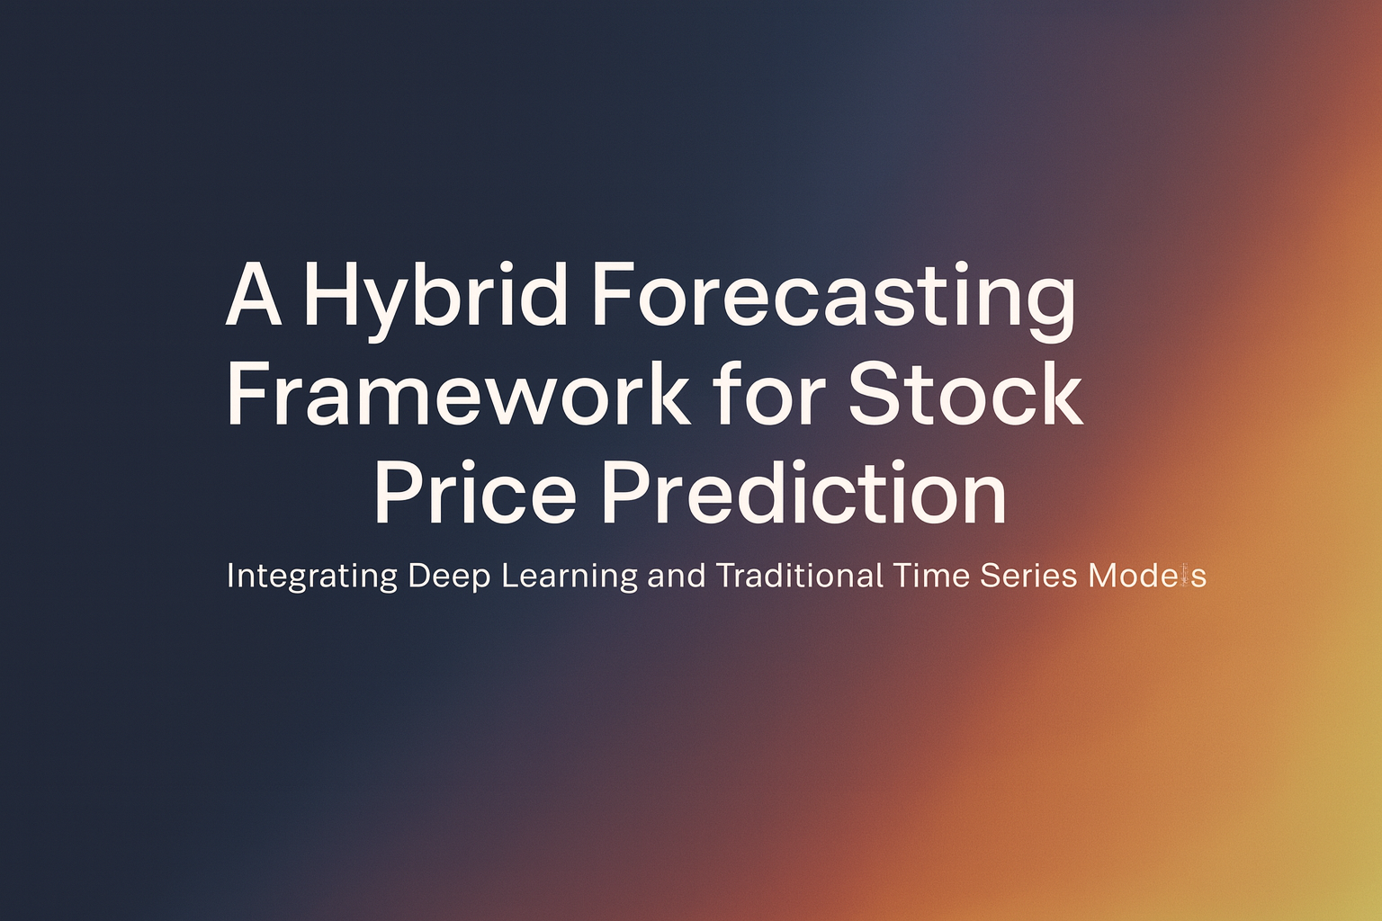
Presented by: T Mojesh
Under the Guidance of: Dr Aswathi R.K
Contact no: 9177139739

Slide 2
Introduction and Problem Statement

Slide 3
Introduction and Problem Statement
Single-model forecasting methods often fail to capture the full dynamics of stock prices

Slide 4
Introduction and Problem Statement
Single-model forecasting methods often fail to capture the full dynamics of stock prices
Traditional models struggle with nonlinearities.

Slide 5
Introduction and Problem Statement
Single-model forecasting methods often fail to capture the full dynamics of stock prices
Traditional models struggle with nonlinearities.
Deep learning models require large data and may overfit

Slide 6
Introduction and Problem Statement
Single-model forecasting methods often fail to capture the full dynamics of stock prices
Traditional models struggle with nonlinearities.
Deep learning models require large data and may overfit
Need a hybrid framework that integrates both for improved accuracy

Slide 7
Introduction and Problem Statement
Single-model forecasting methods often fail to capture the full dynamics of stock prices
Traditional models struggle with nonlinearities.
Deep learning models require large data and may overfit
Need a hybrid framework that integrates both for improved accuracy
Hybrid Model:
TES_ED_DA_CONVLSTM_BO

Slide 8
OBJECTIVES

Slide 9
OBJECTIVES
Develop a hybrid forecasting model combining Smoothing Techniques with LSTM/ConvLSTM.

Slide 10
OBJECTIVES
Develop a hybrid forecasting model combining Smoothing Techniques with LSTM/ConvLSTM.
Improve prediction accuracy and robustness.

Slide 11
OBJECTIVES
Develop a hybrid forecasting model combining Smoothing Techniques with LSTM/ConvLSTM.
Improve prediction accuracy and robustness.
Capture both long-term trends and short-term fluctuations.

Slide 12
OBJECTIVES
Develop a hybrid forecasting model combining Smoothing Techniques with LSTM/ConvLSTM.
Improve prediction accuracy and robustness.
Capture both long-term trends and short-term fluctuations.
Evaluate model performance using standard forecasting metrics.

Slide 13
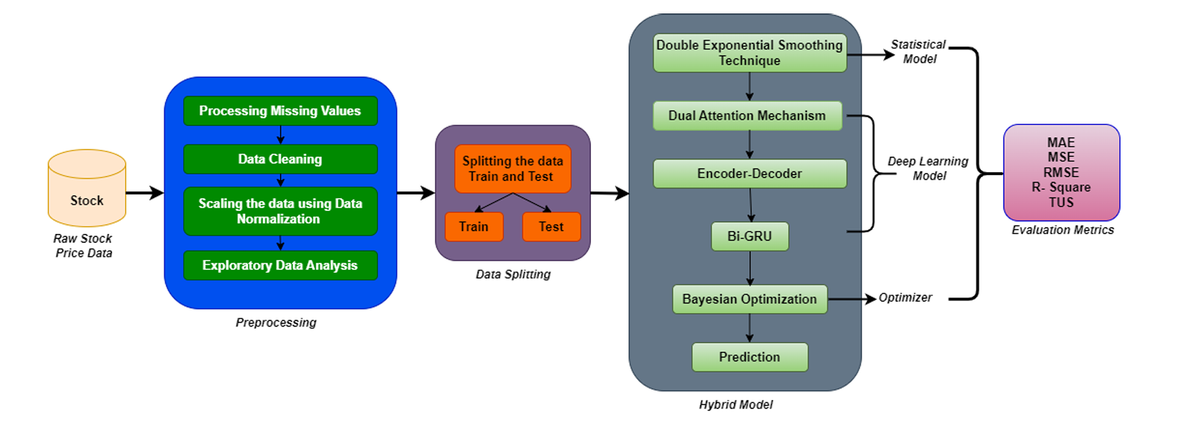
End‑to‑End Pipeline
Triple Exponential Smoothing
Validation
ConvLstm

Slide 14
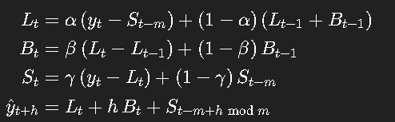
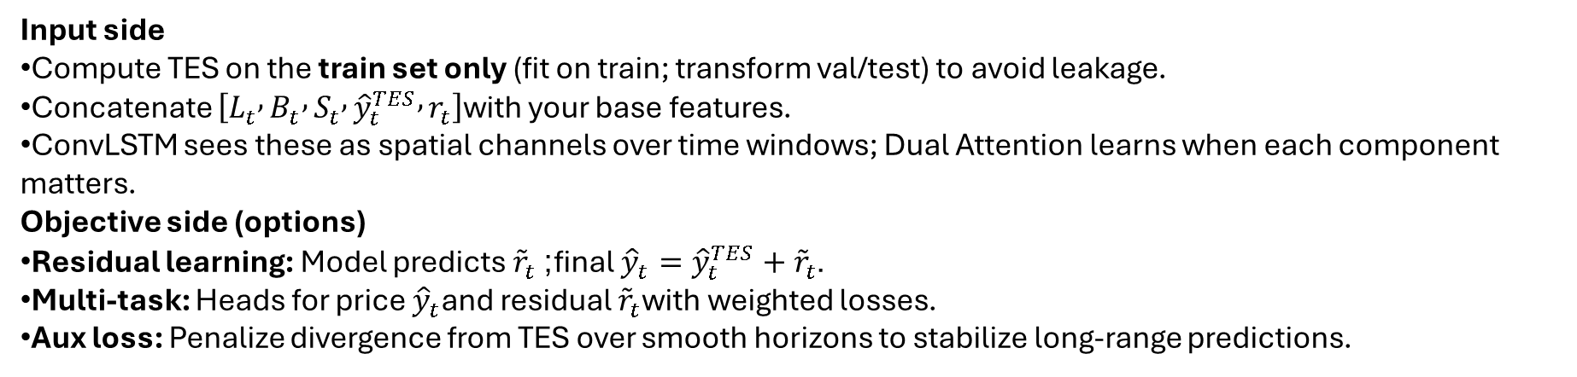
TES gives your hybrid model explicit level/trend/seasonality signals and a strong, low-noise prior. You either predict the residuals on top of TES or use TES components as structured features. This typically boosts stability, generalization, and multi-step accuracy—exactly what an ED + Dual Attention + ConvLSTM + BO stack can leverage best.
Additive seasonality is usually safer for prices/returns; multiplicative can be unstable when levels approach zero.
Input side
Compute TES on the train set only (fit on train; transform val/test) to avoid leakage.
Concatenate $\left[L_{t} , B_{t} , S_{t} , {\hat{y}}_{t}^{TES} , r_{t}\right]$with your base features.
ConvLSTM sees these as spatial channels over time windows; Dual Attention learns when each component matters.
Objective side (options)
Residual learning: Model predicts ${\tilde{r}}_{t}$; final ${\hat{y}}_{t}={\hat{y}}_{t}^{TES}+{\tilde{r}}_{t}$.
Multi-task: Heads for price ${\hat{y}}_{t}$and residual ${\tilde{r}}_{t}$with weighted losses.
Aux loss: Penalize divergence from TES over smooth horizons to stabilize long-range predictions.

Slide 15
About Dataset

Slide 16
About Dataset
Data Collection:
Stock market(GE) dataset were collected through web scraping
Instead of manual extraction, a pre-built Python library ― yfinance ― was used to automatically fetch stock market and financial data from the Yahoo Finance website.

Slide 17
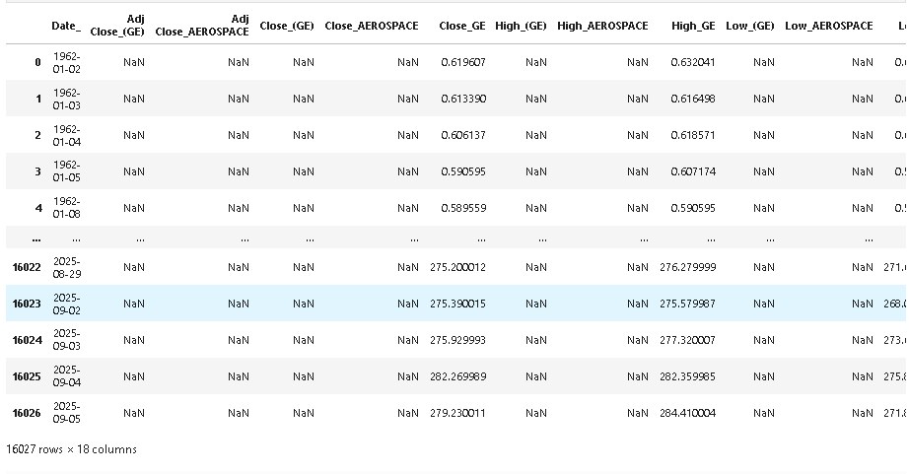
About Dataset
Data Collection:
Stock market(GE) dataset were collected through web scraping
Instead of manual extraction, a pre-built Python library ― yfinance ― was used to automatically fetch stock market and financial data from the Yahoo Finance website.
About Dataset
The dataset, containing daily prices of GE stocks, was collected from Yahoo Finance using the Python yfinance library. It spans from 1962 to 2025 with over 16,027 records and includes essential market features for time series forecasting.

Slide 18
PREPROCESSING

Slide 19
PREPROCESSING
Drop the unnecessary columns:

Slide 20
PREPROCESSING
Drop the unnecessary columns:
Rename the columns:
Index(['Date', 'Close', 'High', 'Low', 'Open', 'Volume'], dtype='object')

Slide 21
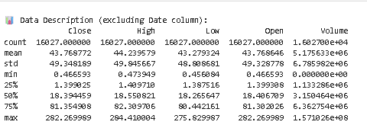
PREPROCESSING
Drop the unnecessary columns:
Rename the columns:
Index(['Date', 'Close', 'High', 'Low', 'Open', 'Volume'], dtype='object')
Data Description:

Slide 22
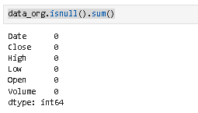
PREPROCESSING
Drop the unnecessary columns:
Rename the columns:
Index(['Date', 'Close', 'High', 'Low', 'Open', 'Volume'], dtype='object')
Data Description:
Checking Null Values:

Slide 23
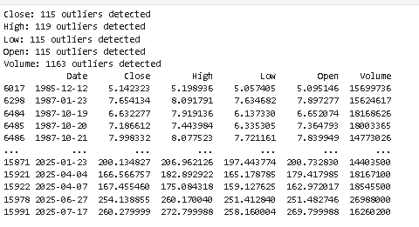
Checking outliers
I applied a two-step normalization process. First, I used RobustScaler to reduce the impact of outliers by scaling data using the median and interquartile range. Then, I applied MinMaxScaler to map all values to a range between 0 and 1, ensuring that all features contribute equally during training. This hybrid scaling approach helped stabilize the learning process and improve model performance.”

Slide 24
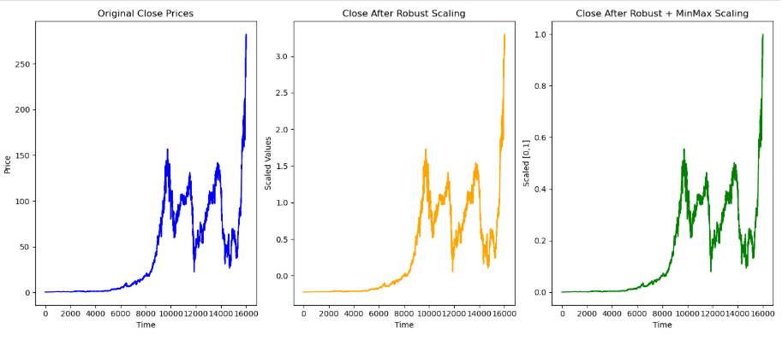
Checking outliers
I applied a two-step normalization process. First, I used RobustScaler to reduce the impact of outliers by scaling data using the median and interquartile range. Then, I applied MinMaxScaler to map all values to a range between 0 and 1, ensuring that all features contribute equally during training. This hybrid scaling approach helped stabilize the learning process and improve model performance.”
Normalization:
Here, I applied a two-step normalization process
Robust scaler
MinMax Scaler

Slide 25
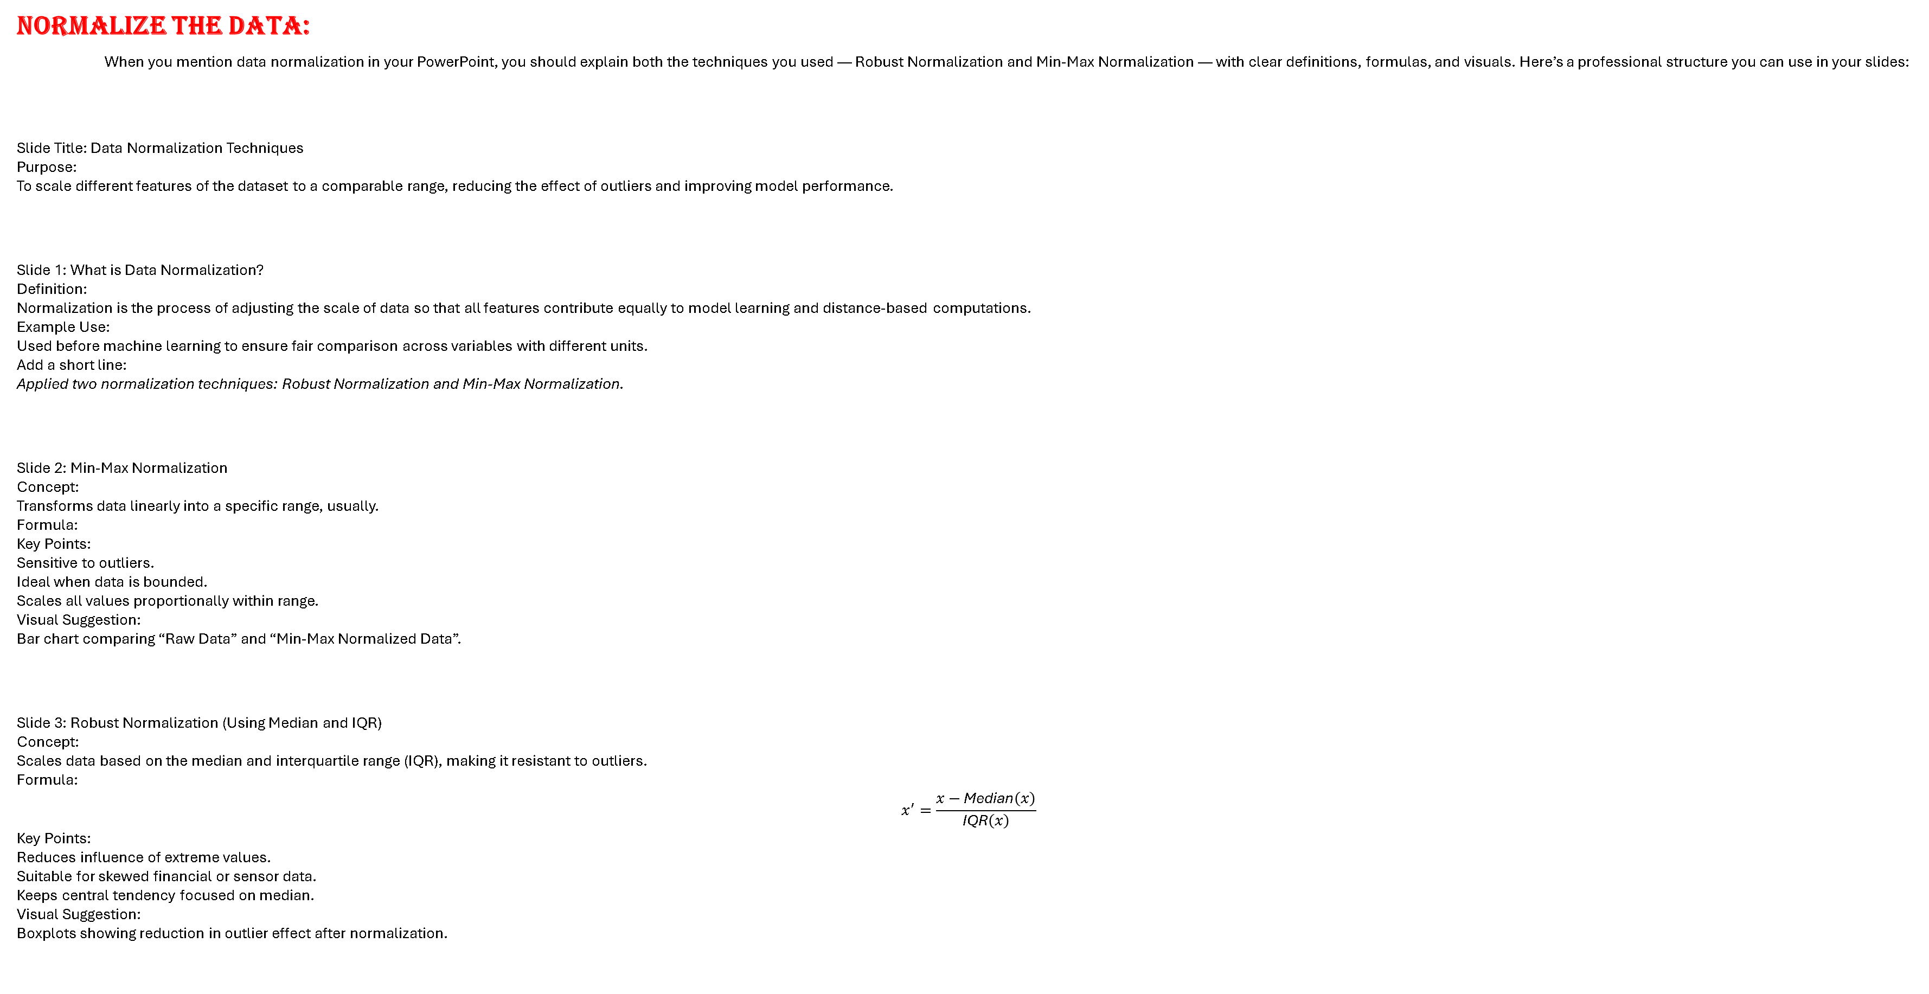
Normalize the Data:
When you mention data normalization in your PowerPoint, you should explain both the techniques you used — Robust Normalization and Min‑Max Normalization — with clear definitions, formulas, and visuals. Here’s a professional structure you can use in your slides:
Slide Title: Data Normalization Techniques
Purpose:
To scale different features of the dataset to a comparable range, reducing the effect of outliers and improving model performance.​
Slide 1: What is Data Normalization?
Definition: Normalization is the process of adjusting the scale of data so that all features contribute equally to model learning and distance‑based computations.​
Example Use: Used before machine learning to ensure fair comparison across variables with different units.
Add a short line:
Applied two normalization techniques: Robust Normalization and Min‑Max Normalization.
Slide 2: Min‑Max Normalization
Concept: Transforms data linearly into a specific range, usually.​
Formula:
Key Points:
Sensitive to outliers.
Ideal when data is bounded.
Scales all values proportionally within range.
Visual Suggestion:
Bar chart comparing “Raw Data” and “Min‑Max Normalized Data”.
Slide 3: Robust Normalization (Using Median and IQR)
Concept: Scales data based on the median and interquartile range (IQR), making it resistant to outliers.
Formula:
$$x^{′}=\frac{x−\text{Median}\left(x\right)}{\text{IQR}\left(x\right)}$$
Key Points:
Reduces influence of extreme values.
Suitable for skewed financial or sensor data.
Keeps central tendency focused on median.​
Visual Suggestion:
Boxplots showing reduction in outlier effect after normalization.

Slide 26
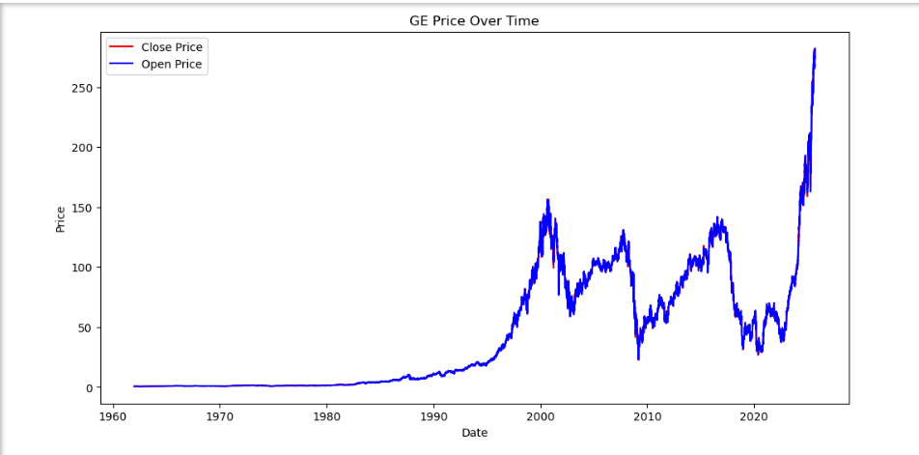
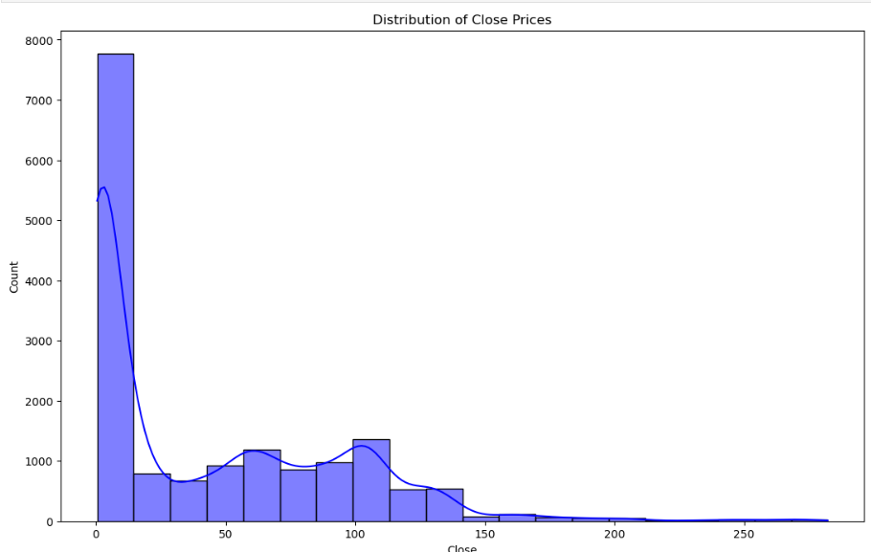
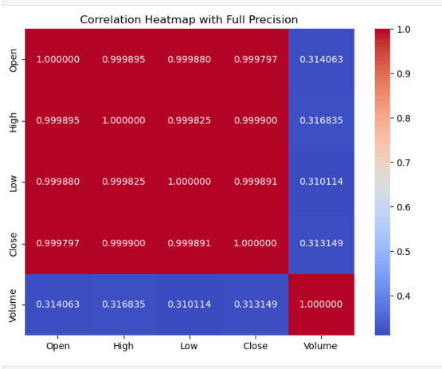
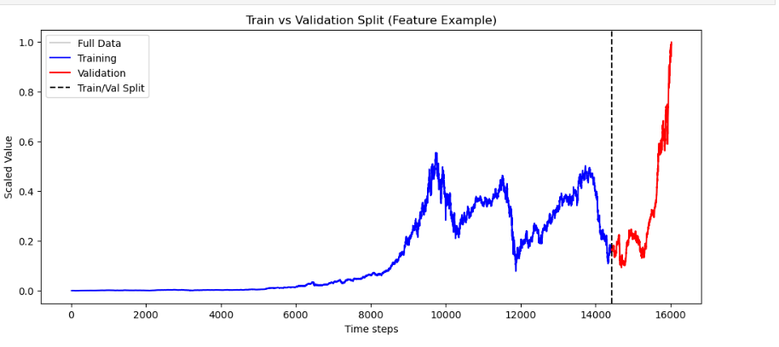
Exploratory Data Analysis
OPEN AND CLOSE Price :
Close Price Distribution:
Correlation Plot:
Training and validation :

Slide 27
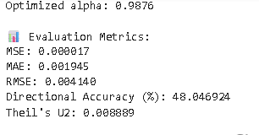
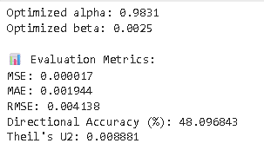
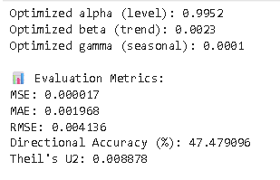
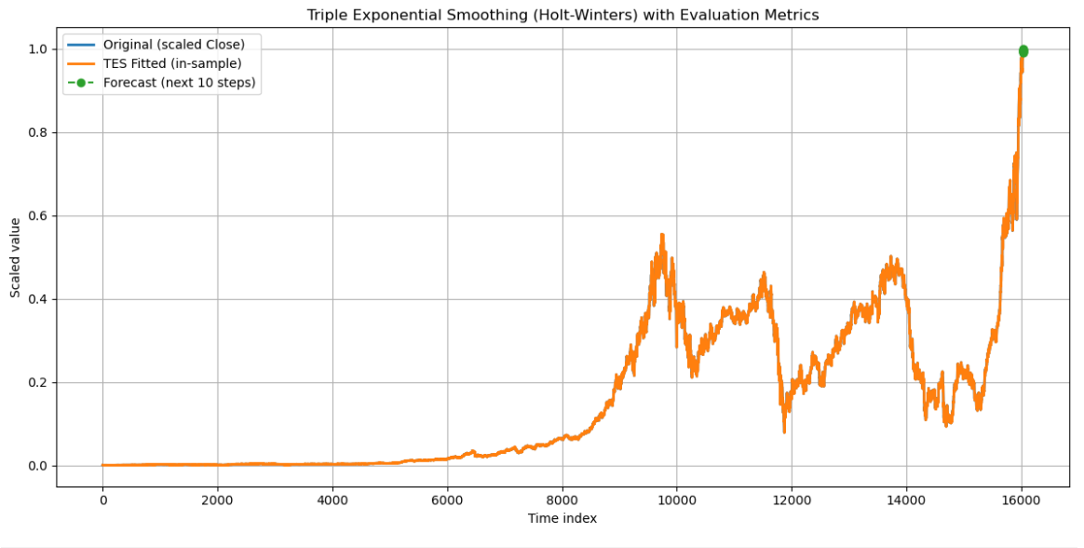
Statistical model
Single Exponential Smoothing:
Double Exponential Smoothing:
Triple Exponential Smoothing:
Based on this result I choose Triple Exponential Smoothing.Because less Theilu’s U

Slide 28
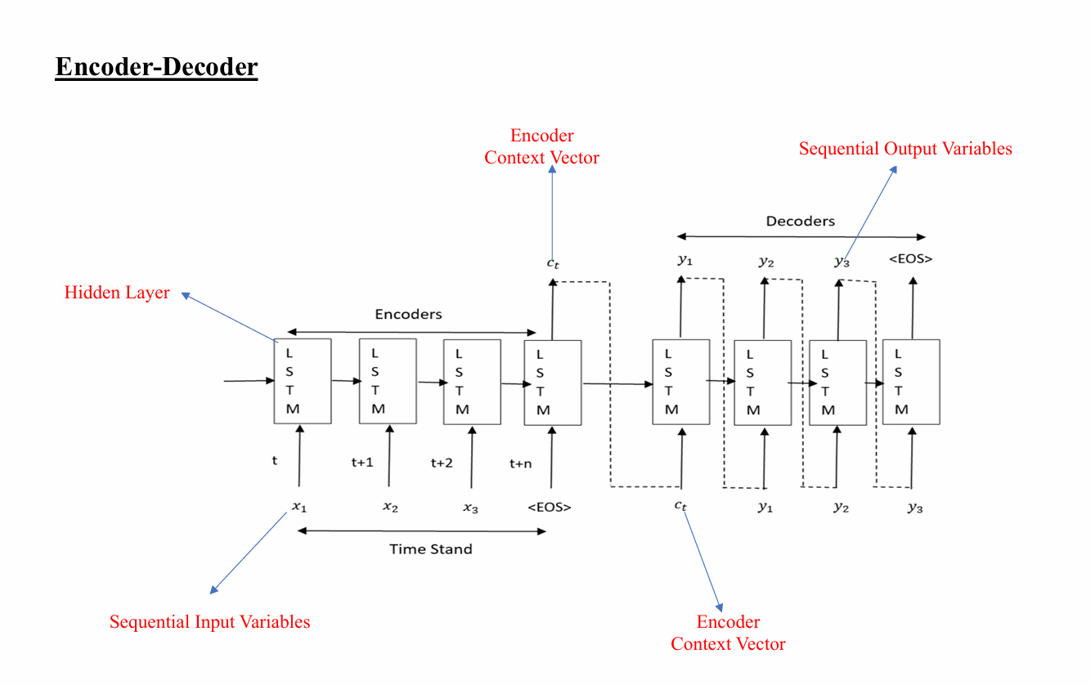
Conv
Lstm
Conv
Lstm
Conv
Lstm
Conv
Lstm
Conv
Lstm
Conv
Lstm
Conv
Lstm
Conv
Lstm

Slide 29
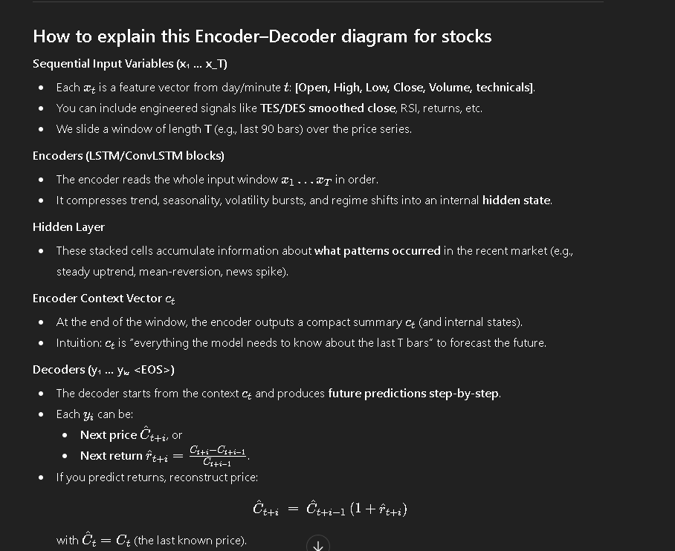
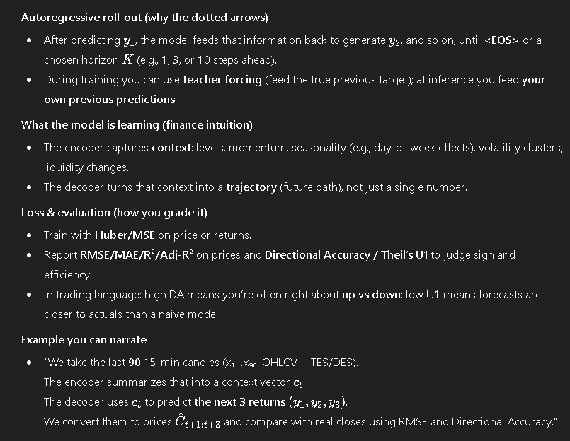
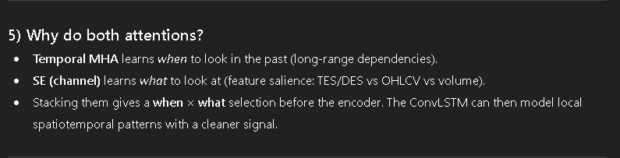

Slide 30
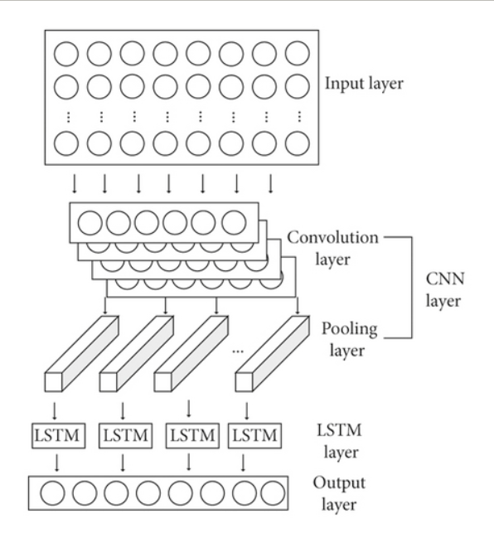
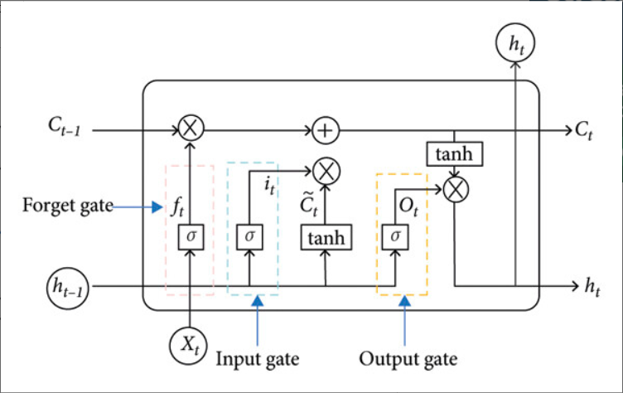
Novelty
CNN_LSTM

Slide 31
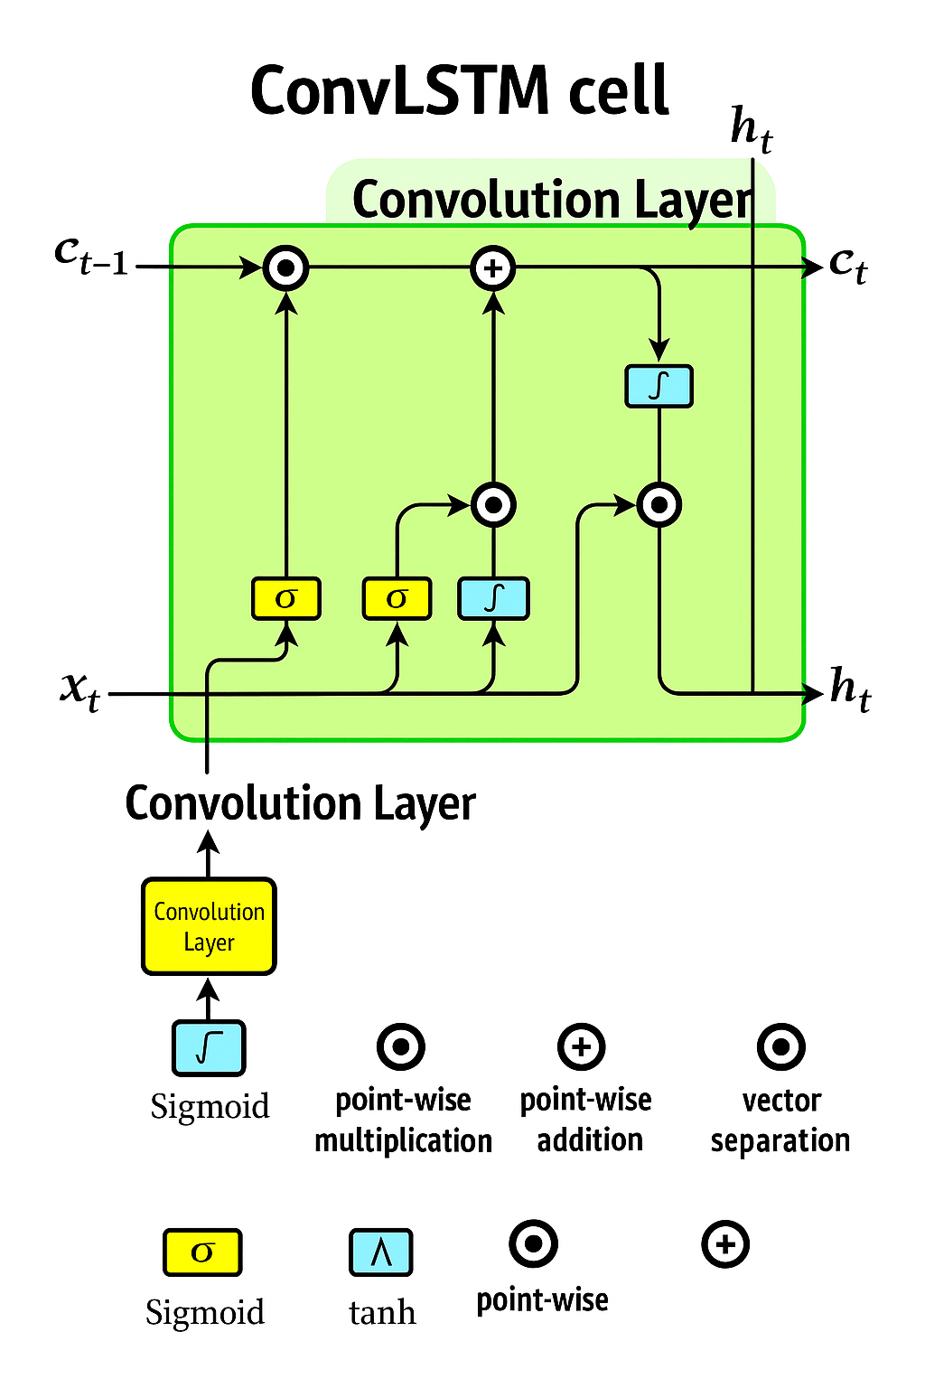
CONVLSTM ARCHITECTURE

Slide 32
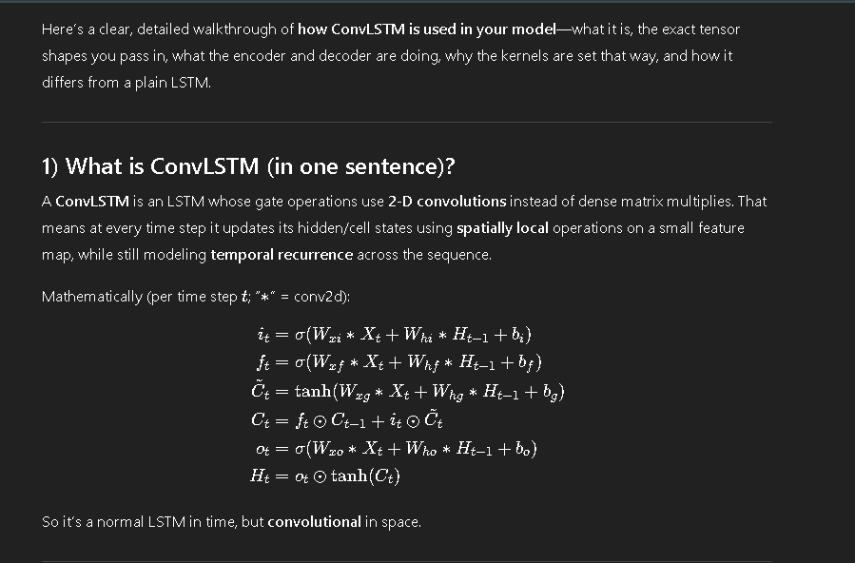
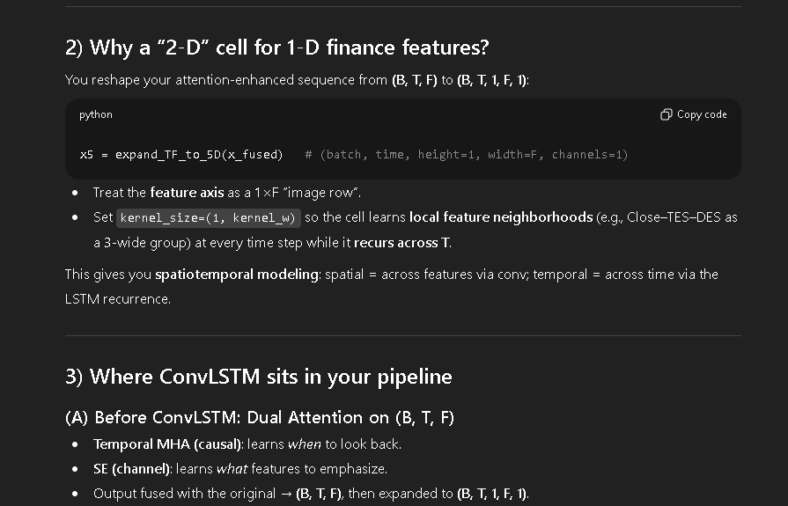
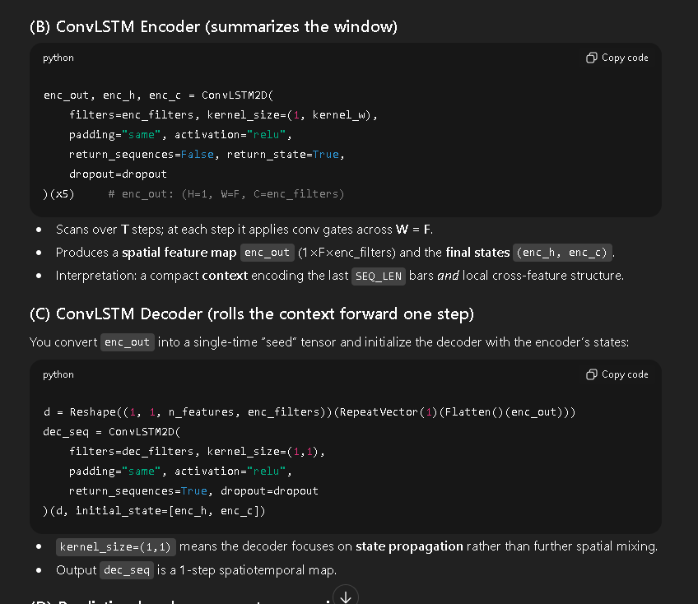
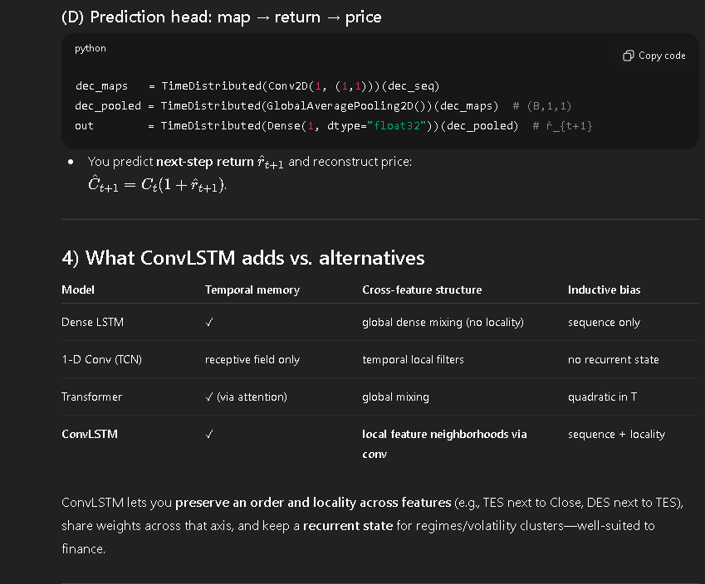

Slide 33
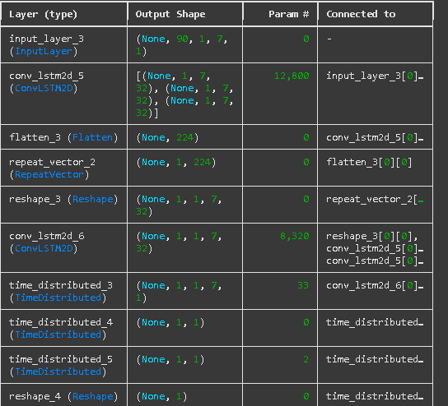
Model Parameters
Total params: 21,155
Trainable params: 21,155
Non-trainable params: 0

Slide 34
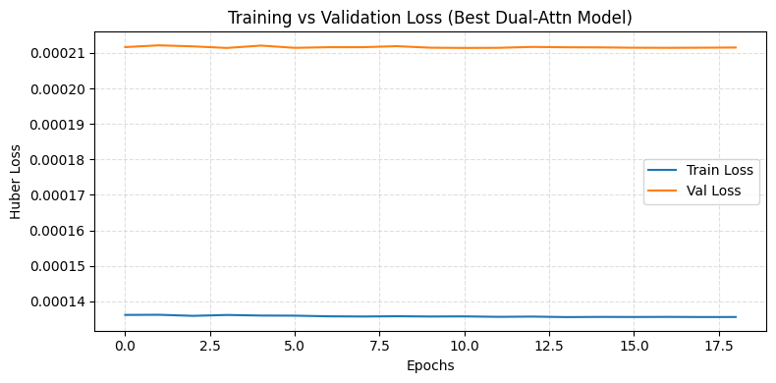
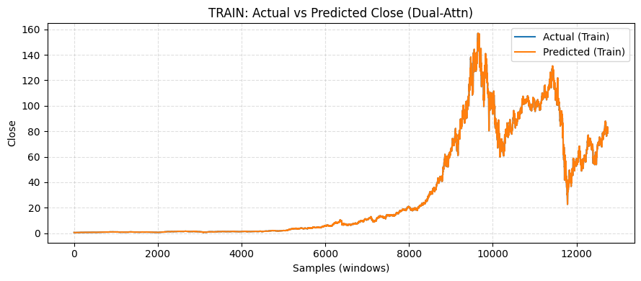
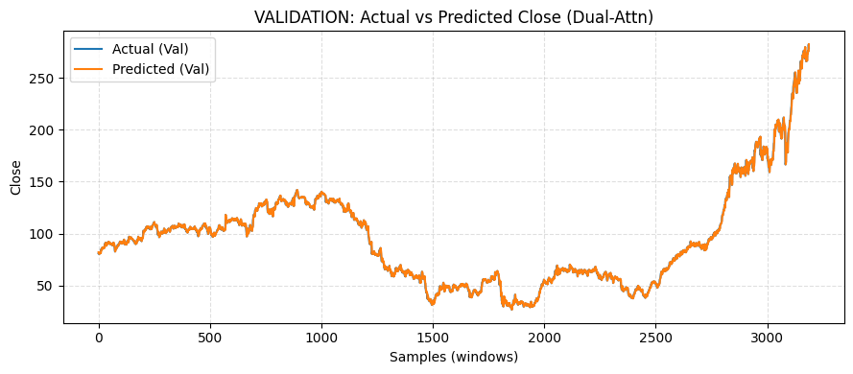
Results
Training & Validation plot
Actual Vs Predict Plot Training
Actual Vs Predict Plot Validation

Slide 35
Model Evaluation
TRAIN Metrics:
MSE : 0.923624
MAE : 0.407312
RMSE : 0.961054
R² : 0.999445
Adj R²: 0.999445
Directional Accuracy (%): 48.07
Theil's U1: 0.009343
VALIDATION Metrics:
MSE : 3.150625
MAE : 1.129541
RMSE : 1.775000
R² : 0.998631
Adj R²: 0.998628
Directional Accuracy (%): 50.60
Theil's U1: 0.008350

Slide 36
Model Comparision
MODEL | MSE | MAE | RMSE | R SQUARE | ADJ R SQUARE | THEILU’S U
BI LSTM | 3.528771 | 1.181292 | 1.878502 | 0.998466 | 0.998460 | 0.008835
ED BI LSTM | 3.814161 | 1.238168 | 1.952988 | 0.998342 | 0.998336 | 0.009200
BI GRU | 3.660722 | 1.218110 | 1.913301 | 0.998409 | 0.998403 | 0.009007
TES_ED_CONVLSTM_BO | 3.189608 | 1.138267 | 1.1785947 | 0.998614 | 0.998611 | 0.008404
HYBRID MODEL | 3.150625 | 1.129541 | 1.775 | 0.998631 | 0.998628 | 0.008350

Slide 37


